Slide 1
THE JAVASCRIPT REVOLUTION
By Komal Singh

Slide 2
Pillars of Web Development
Essentially, just three things: HTML, CSS and JavaScript—the three pillars of the web.
Together, these three pillars make every website work,
defining the content to be displayed (HTML),
telling a browser how to display that content (CSS),
and making the content interactive and modelling its behavior (JavaScript), respectively.

Slide 3
Purpose of JavaScript
JavaScript is a scripting language used to develop web pages. Developed in Netscape, JS allows developers to create a dynamic and interactive web page to interact with visitors and execute complex actions.
In applications like Google Maps, if users want to explore a map, all they have to do is click and drag the mouse to get a detailed view. This is powered by JavaScript, which interacts with the browser without communicating with the servers.
Node.js allows developers to use JavaScript to create a web server. Node.js being event-driven, it moves to the next call without waiting for the response of the previous call, hence avoids buffering.
Various other applications of JavaScript include:
Games (EaselJS library )
Art (Canvas element of HTML5 in JavaScript)
Small robots, creative maker projects, and IoT devices (Node.js ecosystem)
Smart Watches(an example is Pebble.js)
And many more.

Slide 4
The JavaScript Revolution
From its humble beginnings as a language primarily used for adding interactivity to web pages, JavaScript has undergone a revolutionary transformation.
JavaScript was born out of the necessity to make the web more dynamic and responsive. Developed by Brendan Eich in just ten days for Netscape Navigator in 1995, it started as a simple scripting language.
The advent of AJAX (Asynchronous JavaScript and XML) in 2000s marked a turning point, allowing developers to create seamless, asynchronous data exchanges without requiring a page reload. This capability paved the way for more interactive and user-friendly web applications. Before that there was no way to save data with JavaScript. If you wanted data to persist, you had to submit a form to a web server and wait for a page refresh.
Single Page Applications (SPAs) became the new norm, providing a seamless user experience without the need for page reloads.

Slide 5
One of the most significant milestones in its revolution was the introduction of Node.js. Developed by Ryan Dahl in 2009, Node.js allowed developers to use JavaScript on the server side, opening the door for full-stack development with a single language.
The advent of mobile devices brought Frameworks like React Native and frameworks like Ionic which enabled developers to build cross-platform mobile applications using JavaScript. This not only reduced development time but also allowed for code reuse across different platforms.
The NPM (Node Package Manager) has become the largest package registry in the world, hosting millions of reusable packages that have accelerated development and innovation.
JavaScript is also moving into the hardware world. Projects like Arduino, Tessel, Espruino, and NodeBots foreshadow a time in the near future where JavaScript could be a common language for embedded systems and robotics.

Slide 6
Advantages of JavaScript
Performance
Just-in-time compiling:JavaScript is compiled, highly optimized, and executed like native code, so runtime performance is close to that of software written in C or C++.
Objects
JavaScript has very rich object-oriented (OO) features. JavaScript uses a prototypal inheritance model. New objects automatically inherit methods and attributes of their parent object through the prototype chain.
Syntax
The JavaScript syntax should be immediately familiar to anybody who has experience with C-family languages, such as C++, Java, C#, and PHP.

Slide 7
Events
Inside the browser, everything runs in an event loop. Operations that might block processing in other languages happen concurrently in JavaScript.
Reusability
JavaScript code, by virtue of its ubiquity, is the most portable, reusable code around.

Slide 8
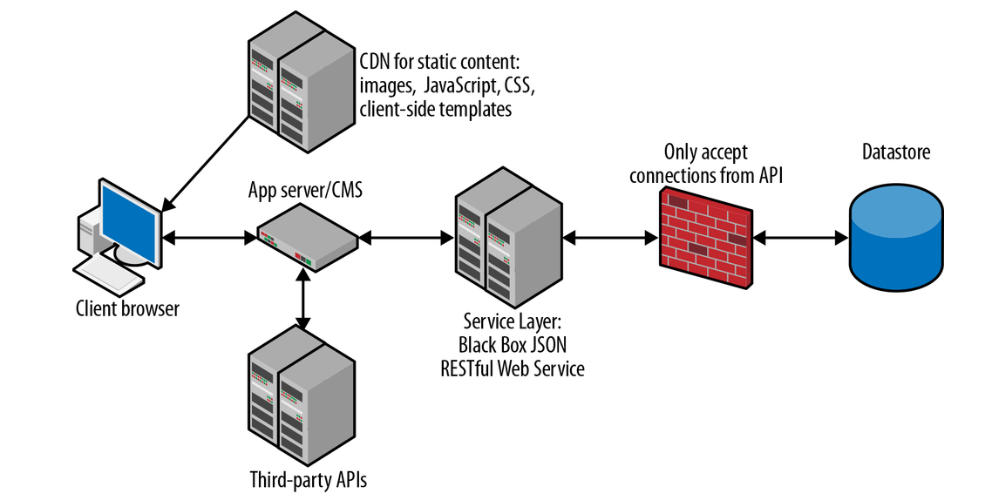
Anatomy of a Typical Modern JavaScript App
Data store
A virtual private network (VPN) or firewall (to protect the data store from unauthorized access)
A black box JSON RESTful Web Service Layer
Various third-party APIs
An app server/content management system (CMS) to route requests and deliver pages to the client
A static content deliver network (CDN) for cached files (like images, JavaScript, CSS, and client-side templates)
The client (browser)

Slide 9
